Slide 1
Open vSwitch
Guido Appenzeller, VMware

Slide 2
“Software is eating the World.”
Marc Andreessen

Slide 3
Software is eating the World
Hardware/Physical
Software
Sun Microsystems
Blockbuster
Tower Records
Barnes & Nobles
Microsoft
Netflix
Itunes
Amazon
This is true for networking as well.
Notes:
Marc. Software driven industry in contact with classical, software wins.
Why? Primarily the faster innovation cycles.
Upgrade SW easier than HW
Develop, Test, Distribute, Re-use etc.

Slide 4
Virtual Ports outnumber Physical Ports in the Data Center
Math:
2-3 physical ports/server
1-2 virtual ports/VM
Assume 50% of HW virtualized, 5 VM’s average
Over 65% of ports are virtual.

Slide 5
Virtual Ports are the new Network Edge
Edge Ports are more Important than ports in the core
Services are pushed to the edge
Easier to maintain state close to the edge
Keep the core simple and fast (routed, tags)
Virtual Ports have Unique Advantages
Only place to intercept inter-VM traffic
State that scales out with number of VMs
“Golidlocks” zone that is a separate security zone from guest VM, but can access guest VMresources

Slide 6
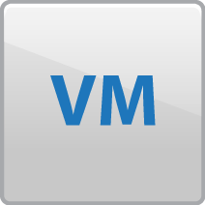
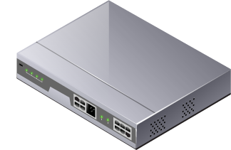
Decoupling Hardware and Software
Virtual Network
Innovate at Software Speed
Rich Edge Services
Security
vSwitch
vSwitch
Physical Network
Innovate at Hardware Speed
Performance and Scale
Keep it Simple
Notes:
Virtual Switches are the most important part of the Data Center Network
With vSwitches, networking software is decoupled from hardware
This allows for rapid innovation

Slide 7
Networking needs innovation. Badly.

Slide 8
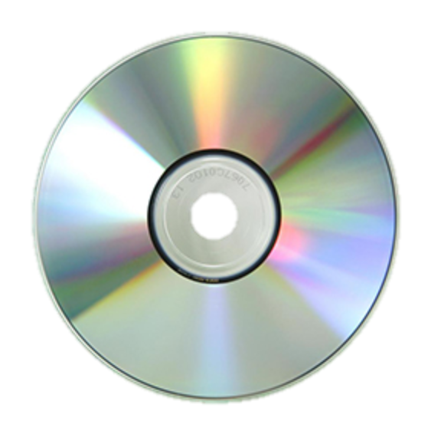
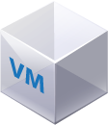
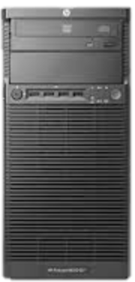
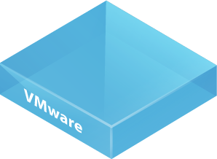
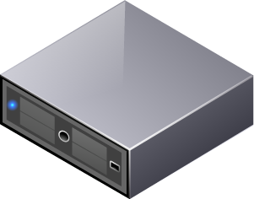
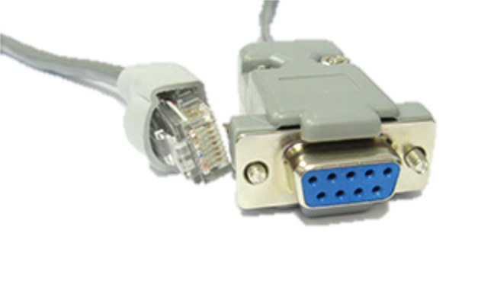
Evolution of server provisioning
Setting up a server 1994
Setting up a server 2014
Insert CD Rom
Connect serial cable
Install Windows/Linux
PXE boot
ESX Hypervisor + vCenter
Puppet, Chef etc.

Slide 9
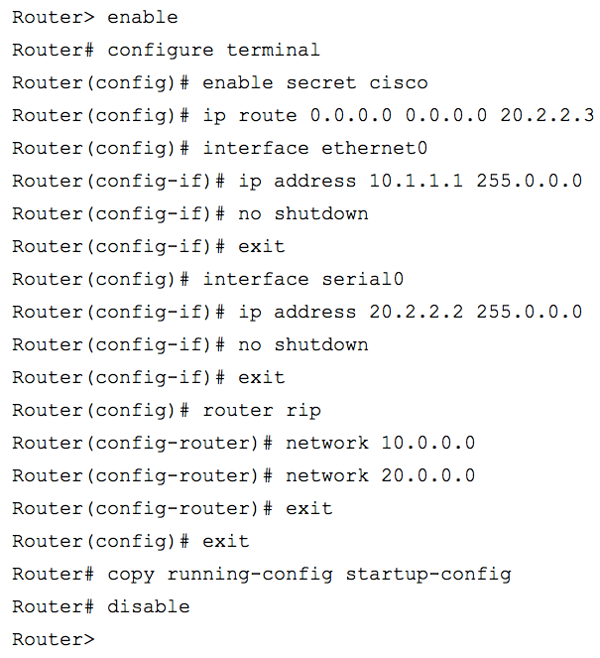
Evolution of network provisioning: 1996-2013
1996
2014
Terminal Protocol: Telnet
Terminal Protocol: SSH

Slide 10
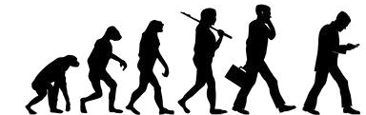


Compute Evolution
Networking Evolution
SSH

Slide 11
Why is VMware supporting OVS?
Notes:
Evil plan to subvert OpenStack from the inside?
hope convinced that this is not the case
large number of customers running OpenStack KVM and NSX
Announce OpenStack with ESX underneath
Purely altruistic and for the betterment of mankind?
Not quite either.
We build and sell network virtualization technology
Couldn’t we build this closed?

Slide 12
OpenStack/KVM Data Center
OpenStack
Apache
Apache
Apache
Apache
Linux (Guest)
Linux (Guest)
Linux (Guest)
Linux (Guest)
Open vSwitch
KVM
KVM
KVM
KVM
Linux
Linux

Slide 13
Our take on OVS
We are committed to keeping Open vSwitch open
We have no illusions about what that means:
Used by our competitors. And that’s ok.
Vast majority of people using OVS are doingit without a VMware product. That’s ok too.
Our goal is to keep Open vSwitch is a production quality foundation for great SDN products and systems.

Slide 14
How is Open vSwitch doing?

Slide 15
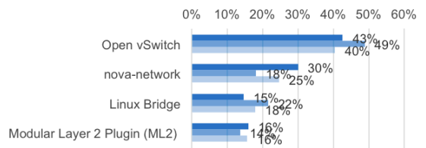
Open vSwitch and OpenStack
OVS is #1 for OpenStack
43% of Production
49% of Dev/QA
40% of PoC
OVS more popular than the “default”.

Slide 16
Mailing Lists
Mailing List | Subscribers
discuss@openvswitch.org | 1544
announce@openvswitch.org | 883
dev@openvswitch.org | 839
git@openvswitch.org | 175

Slide 17
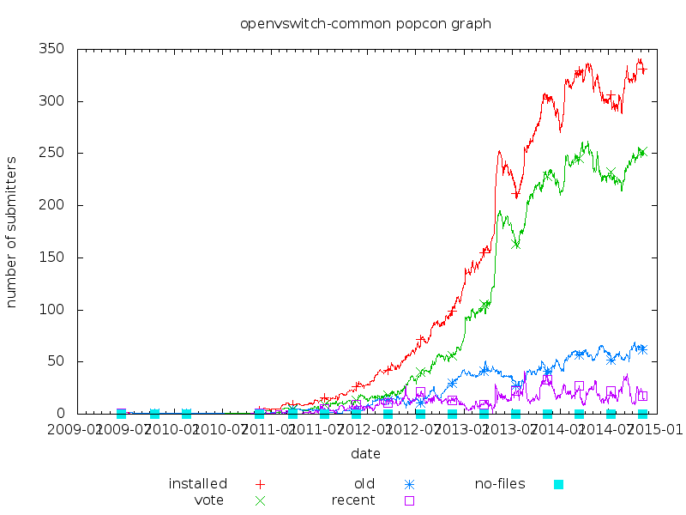
Open vSwitch and Linux
Used in 0.16% of Debian Installations (compare to qemu-kvm at 2.36%)
Notes:
1/625

Slide 18
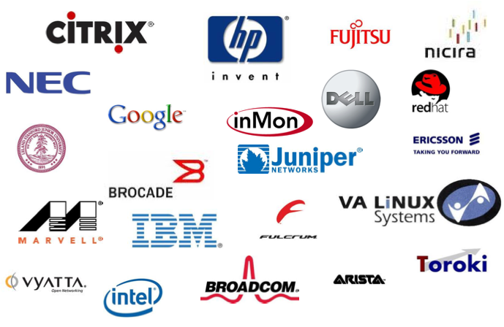



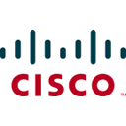


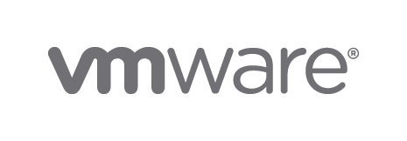
(Incomplete) List of Contributors

Slide 19
Thanks to you!
(who build Open vSwitch)

